Slide 1
Implementing an Event Sourcing strategy on Azure
Eldert Grootenboer
Olena Borzenko

Slide 2




Introduction
Olena Borzenko
Xpirit
@borzenko_lena
Eldert Grootenboer
Microsoft
Program Manager Azure Service Bus
@egrootenboer
Notes:
O & E

Slide 3
Event Sourcing

Slide 4
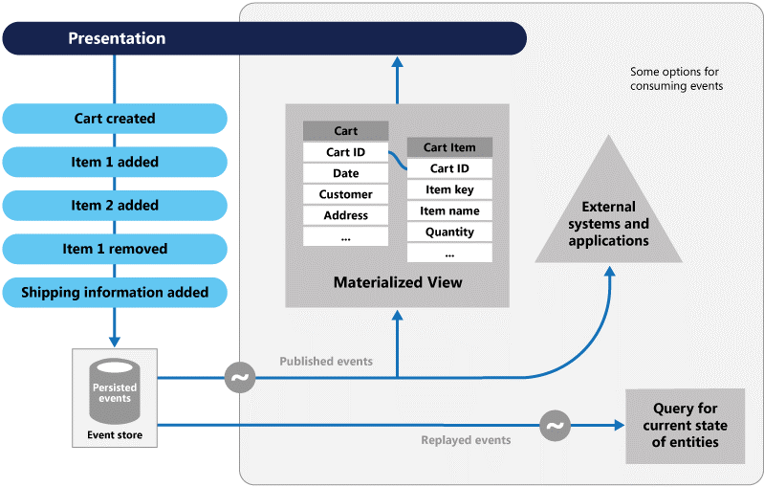
Event Sourcing
Event Sourcing pattern Cloud Design Patterns Microsoft Docs

Slide 5
Why use Event Sourcing?
CRUD
Locking data
No history
Not easily scalable
Notes:
Most applications work with data, and the typical approach is for the application to maintain the current state of the data by updating it as users work with it. For example, in the traditional create, read, update, and delete (CRUD) model a typical data process is to read data from the store, make some modifications to it, and update the current state of the data with the new values—often by using transactions that lock the data.
The CRUD approach has some limitations:
CRUD systems perform update operations directly against a data store, which can slow down performance and responsiveness, and limit scalability, due to the processing overhead it requires.
In a collaborative domain with many concurrent users, data update conflicts are more likely because the update operations take place on a single item of data.
Unless there's an additional auditing mechanism that records the details of each operation in a separate log, history is lost.

Slide 6
Event sourcing pattern
Write-heavy workloads
Inserts are more efficient
Built-in audit log
Don’t update objects
Notes:
Write-heavy workloads. Store each event as an immutable document, instead of updating state in-place
AddEventForObject(ObjectId, EventType, Timestamp)
GetEventsForObject(ObjectId, EventType)
GetEventsSinceTimestamp(Timestamp)
Why event-driven architectures?
Inserts are more efficient than update at scale
Built-in audit log of events
Decoupled micro-services that act on events
GetEventsForObject is a single-partition query to get latest state on read QUESTION from Olena: You mentioned before problems with scalability, can you tell us how it will work in this case?

Slide 7
Event Sourcing on Azure

Slide 8
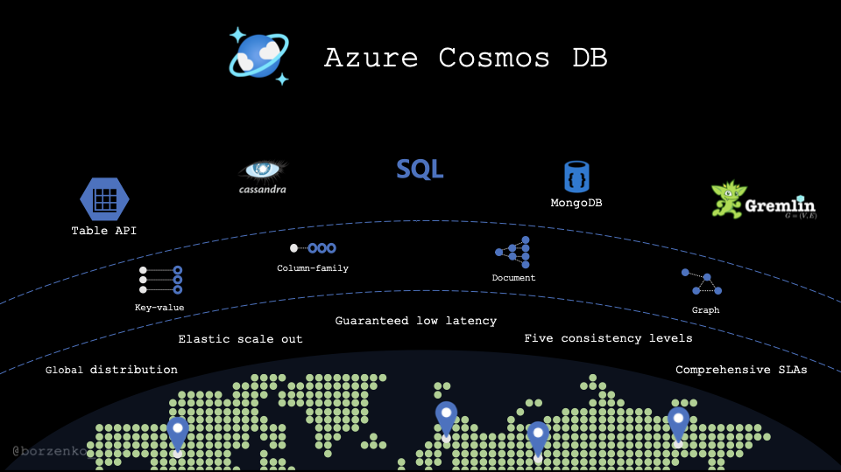
Event Sourcing on Azure
Cosmos DB
Event Hubs
Azure Functions
Event Grid
Service Bus
Notes:
Cosmos DB: Olena
Event Hubs: Eldert
Azure Functions: Olena

Slide 9




Demo time!
Notes:
Who here is working with Kafka?

Slide 10




Demo time!
Notes:
A Kafka producer with Event Hubs endpoint creates events around orders. Systems which implement a CQRS style of retrieving the data can use these projections. The Event Hub could also be the input for an analytics stream using Azure Stream Analytics.
Order created
Item added
Shipping info added
Order confirmed
A Function reads the Event Hubs stream, does optional business logic, and creates / updates a projection of the order in Cosmos DB.
When the order confirmed event arrives, the Function executes a transaction which updates the projection in Cosmos DB, and also creates an event on Event Grid, containing the identifier of the order.
This event is handled by a Function, which retrieves the data of the order, and creates a command for the fulfilment system.
A Function is triggered from the change feed, and retieves the number of documents per warehouse, which are stored in a projection in another Cosmos DB. Each warehouse monitor system can see these counters for their warehouse.

Slide 11
Materialized view
Notes:
Why whould we use materialized view? In traditional way when we need to read our data we'd create a query and call it when we need it. With cosmosDB we might want to do it differently because our queries most likely will be quite expensuve. Especially when we have cross partition queries.

Slide 12
Creating a materialized view
More efficient querying
Pre-populated views
Update on change
Cosmos DB Change Feed
Notes:
Materialized View pattern. The data store used in a system based on event sourcing is typically not well suited to efficient querying. Instead, a common approach is to generate prepopulated views of the data at regular intervals, or when the data changes. Shows how this can be done.

Slide 13
Materialized Views
Application
Azure Cosmos DB
Materialized View
Order | User | Create Date | …
123abc | Ben6 | 6/17/17
456efg | Ben6 | 3/14/17
789hij | Jen4 | 8/1/16
012klm | Joe3 | 3/4/17
User | Total Orders
Ben6 | 2
Jen4 | 1
Joe3 | 1
Change feed
Notes:
QUESTION: We used to normalize all our data, to prevent duplication as much as possible. This, however, sounds like you will be duplicating data for your different views. Can you elaborate on this?

Slide 14
Demo time!

Slide 15
Demo time!
Notes:
A Kafka producer with Event Hubs endpoint creates events around orders. Systems which implement a CQRS style of retrieving the data can use these projections. The Event Hub could also be the input for an analytics stream using Azure Stream Analytics.
Order created
Item added
Shipping info added
Order confirmed
A Function reads the Event Hubs stream, does optional business logic, and creates / updates a projection of the order in Cosmos DB.
When the order confirmed event arrives, a the Function executes a transaction which updates the projection in Cosmos DB, and also creates an event on Event Grid, containing the identifier of the order.
This event is handled by a Function, which retrieves the data of the order, and creates a command for the fulfilment system.
A Function is triggered from the change feed, and retieves the number of documents per warehouse, which are stored in a projection in another Cosmos DB. Each warehouse monitor system can see these counters for their warehouse.

Slide 16
Almost done!

Slide 17
Key take-aways
Use the Azure eco-system for easy and powerful solutions
Cosmos DB is a great central append-only persistent data store
Prepare materialized views for various consumers
Use event-sourcing on Azure with heavy write loads
Notes:
Olena
Eldert
Olena
Eldert
Synapse

Slide 18
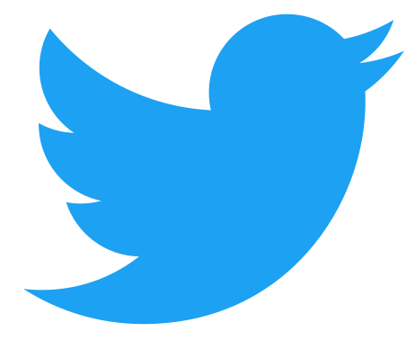


Thank you!
@borzenko_lena
olena-borzenko
borzenko.olena
@egrootenboer
eldert-grootenboer
eldert.grootenboer
https://github.com/EldertGrootenboer/Implementing-an-Event-Sourcing-strategy-on-Azure

